Slide 1
Unit-2.3 Analog Transmission
Prepared By:
Prof. Vishal A. Polara
Assistant Professor
Information Technology Department
Birla Vishvakarma Mahavidyalaya Engineering College

Slide 2
Outline
1. DIGITAL TO ANALOG CONVERSION
Amplitude shift keying(ASK)
Frequency shift keying(FSK)
Phase shift keying(PSK)
2. ANALOG TO ANALOG CONVERSION
Amplitude Modulation
Frequency Modulation
Phase Modulation

Slide 3
1. Digital to analog conversion
Digital to analog conversion is the process of changing one of the characteristics of an analog signal based on the information in digital data.
There are four mechanism base on altering parameter of sine wave:
Amplitude shift keying(ASK)
Frequency shift keying(FSK)
Phase shift keying(PSK)
Quadrature amplitude modulation(QAM)

Slide 4
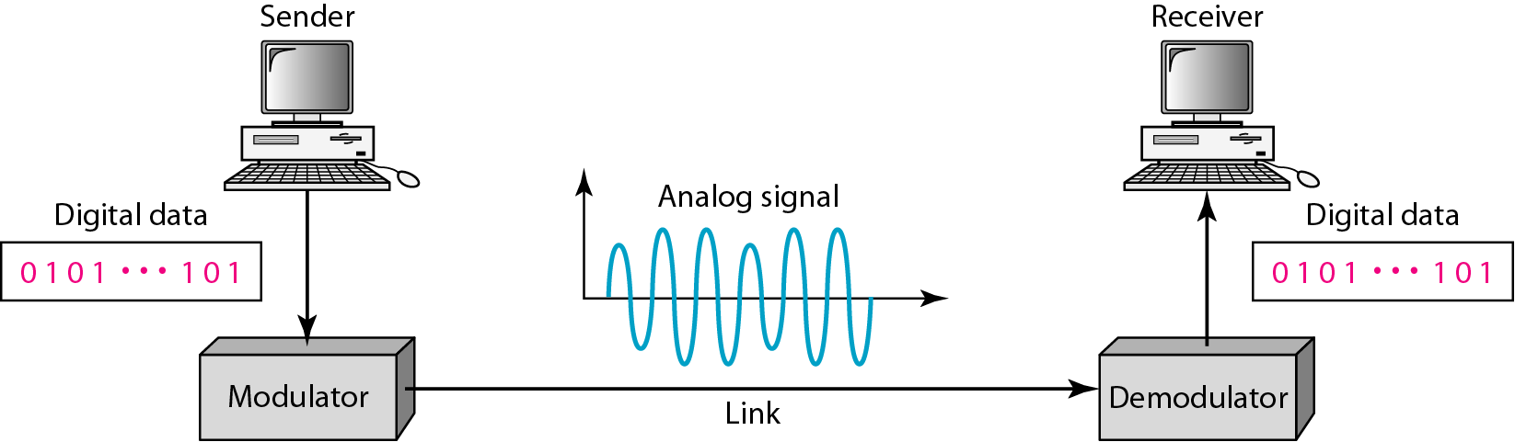
Figure Digital-to-analog conversion

Slide 5
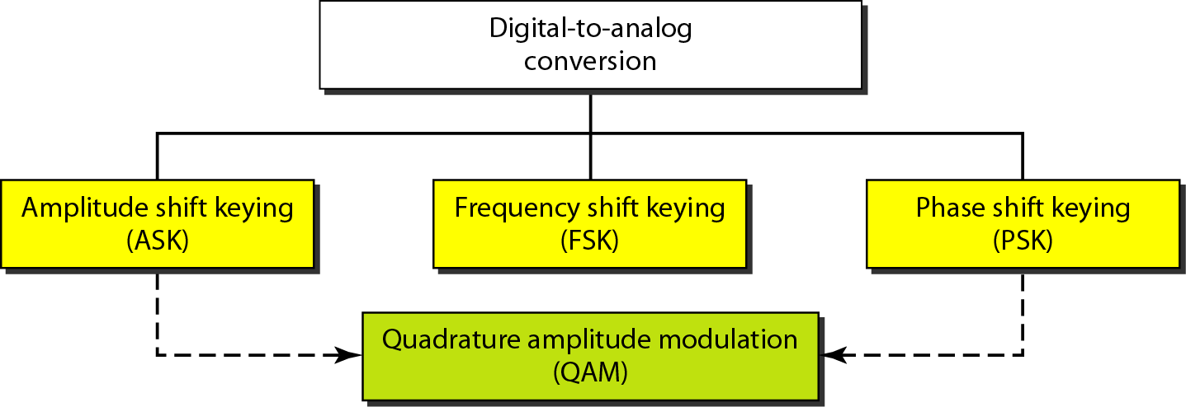
Figure Types of digital-to-analog conversion

Slide 6
Bit rate is the number of bits per second.
Baud rate is the number of signal elements per second.
In the analog transmission of digital data, the baud rate is less than or equal to the bit rate.
In analog transmission, the sending device produces a high-frequency signal that acts as a base for the information signal. This base signal is called the carrier signal or carrier frequency.

Slide 7
Example
An analog signal carries 4 bits per signal element. If 1000 signal elements are sent per second, find the bit rate.
Solution
In this case, r = 4, S = 1000, and N is unknown. We can find the value of N from

Slide 8
Example
An analog signal has a bit rate of 8000 bps and a baud rate of 1000 baud. How many data elements are carried by each signal element? How many signal elements do we need?
Solution
In this example, S = 1000, N = 8000, and r and L are unknown. We find first the value of r and then the value of L.

Slide 9
Bandwidth:
The required bandwidth for analog transmission of digital data is proportional to the signal rate except for FSK
Carrier Signal:
In analog transmission, the sending device produces a high-frequency signal that acts as a base for the information signal. This base signal is called the carrier signal or carrier frequency.
Modulation:
The receiving device is tuned to the frequency of the carrier signal that it expects from the sender. Digital information then changes the carrier signal by modifying one or more of its characteristics (amplitude, frequency, or phase). This kind of modification is called modulation (shift keying).

Slide 10
1. Amplitude shift keying(ASK)
In this technique the amplitude of the carrier signal is varied to create signal elements.
Both frequency an phase remain constant while the amplitude changes.
ASK is normally implemented using two levels. It is called binary amplitude shift keying or on-off keying(OOK).
Here the peak amplitude of one signal level is 0 and other is the same as the amplitude of the carrier frequency.

Slide 11
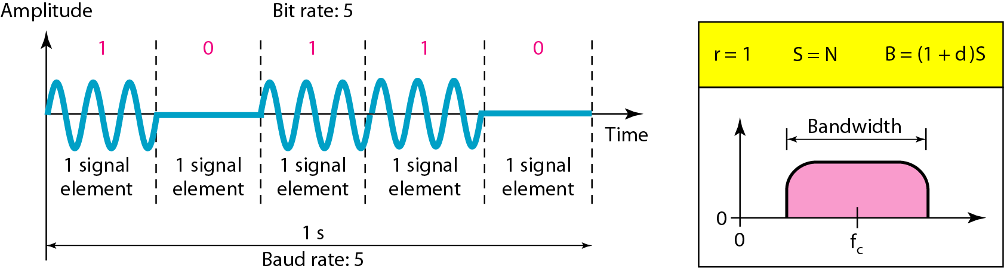
1. Amplitude Shift Keying (ASK)
1.1 Binary ASK (BASK)
Figure Binary amplitude shift keying

Slide 12
Implementation of BASK
Here unipolar NRZ signal multiply with carrier signal coming from an oscillator.
When the amplitude of the NRZ signal is 1 the amplitude of the carrier frequency is held and when the amplitude of NRZ signal is 0 the amplitude of the carrier frequency is zero.

Slide 13
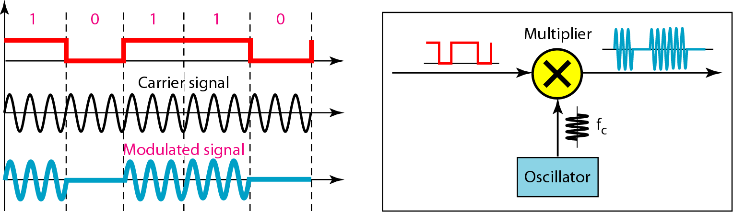
Figure Implementation of binary ASK

Slide 14
1.2 Multilevel ASK (MASK)
There are more than two levels.
We can use 4,8, 16, or more different amplitudes for the signal and modulate the data using 2, 3, 4, or more bits at a time.
In these cases, r = 2, r = 3, r =4, and so on.

Slide 15
Example
We have an available bandwidth of 100 kHz which spans from 200 to 300 kHz. What are the carrier frequency and the bit rate if we modulated our data by using ASK with d = 1?
Solution
The middle of the bandwidth is located at 250 kHz. This means that our carrier frequency can be at f_{c} = 250 kHz. We can use the formula for bandwidth to find the bit rate (with d = 1 and r = 1).

Slide 16
2. Frequency shift keying(FSK)
In this technique frequency of the carrier signal is varied to represent data.
The frequency of the modulated signal is constant for the duration of one signal element but changes for the next signal element if the data element changes.
Here in BFSK we used to carrier frequency f1 and f2. f1 is used when data element is 0 and f2 is used when data element is 1.

Slide 17
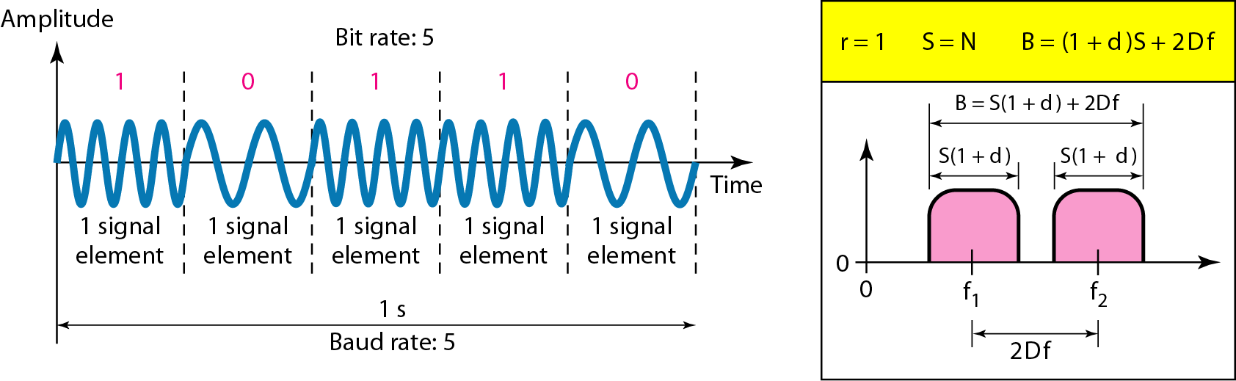
2. Frequency Shift Keying (FSK)
2.1 Binary FSK (BFSK)
Figure Binary frequency shift keying

Slide 18
Example
We have an available bandwidth of 100 kHz which spans from 200 to 300 kHz. What should be the carrier frequency and the bit rate if we modulated our data by using FSK with d = 1?
Solution
This problem is similar to Example 5.3, but we are modulating by using FSK. The midpoint of the band is at 250 kHz. We choose 2Δf to be 50 kHz; this means

Slide 19
Implementation of BFSK
There are two way BFSK implemented: noncoherent and coherent.
In in noncoherent BFSK there may be discontinuity in the phase when one signal element ends and the next begins.
In coherent BFSK the phase continues through the boundary of two signal elements.
Non coherent BFSK is treated as two ASK modulations using two carrier frequencies.
Coherent BFSK implemented using Voltage controlled oscillator(VCO).
The input to the oscillator is the unipolar NRZ signal. When the amplitude of NRZ is zero, the oscillator keeps its regular frequency, when the amplitude is positive the frequency is increased.

Slide 20
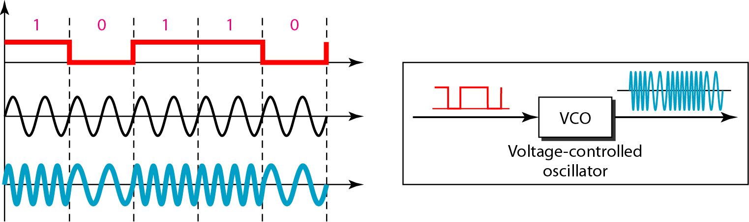
Figure Implementation of BFSK

Slide 21
2.2 Multilevel FSK (MFSK)
Example
We need to send data 3 bits at a time at a bit rate of 3 Mbps. The carrier frequency is 10 MHz. Calculate the number of levels (different frequencies), the baud rate, and the bandwidth.
Solution
We can have L = 23 = 8. The baud rate is S = 3 MHz/3 = 1000 Mbaud. This means that the carrier frequencies must be 1 MHz apart (2Δf = 1 MHz). The bandwidth is B = 8 × 1000 = 8000. Figure 5.8 shows the allocation of frequencies and bandwidth.

Slide 22
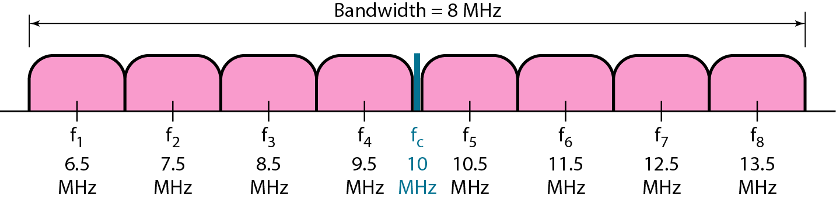
Figure Bandwidth of MFSK

Slide 23
3. Phase shift keying(PSK)
In this technique phase of the carrier is varied to represent two or more different signal elements.
PSK is most widely used than ASK or FSK.
The simplest PSK is binary PSK in which we have only two signal elements, one with a phase of 0 degree and other with a phase of 180 degree.
Binary PSK is less susceptible to noise than ASK. Noise can change the amplitude easier than it can change the phase .
PSK is superior to FSK because we do not need two carrier signals.

Slide 24
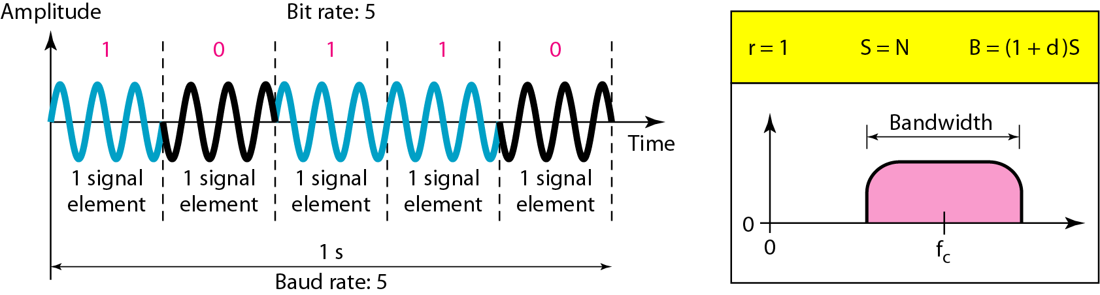
3. Phase Shift Keying (PSK)
3.1 Binary PSK (BPSK)
Figure Binary phase shift keying

Slide 25
Implementation of BPSK
Here signal element of 180 degree can be seen as the complement of the signal element with phase 0 degree.
Here we use polar NRZ signal instead of unipolar NRZ signal.
The polar NRZ signal is multiplied by the carrier frequency, the 1 bit is represented by a phase starting at 0 degree and the 0 bit is represented by a phase starting at 180 degree.

Slide 26
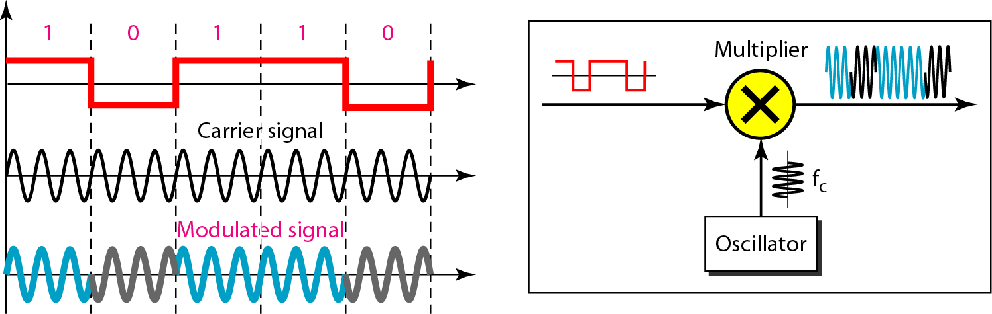
Figure Implementation of BPSK

Slide 27
4. Quadrature phase shift keying(QPSK)
It is called QPSK because it uses two separate BPSK modulations. One is in phase the other out of phase(quadrature).
The incoming bits are first passed through a serial to parallel conversion that sends one bit to one modulator and the next bit to the other modulator.
If the duration of each bit in incoming signal is T then in BPSK signal is 2T.
Each bit in BPSK signal has one half the frequency of the original signal.
Two composite signals created by each multiplier are sine waves with the same frequency but different phase.
When they are added the result is another one wave with one of four possible phase: 45, -45, 135 and -135 degree.
There are four kinds of signal elements in the output signal so we can send 2 bits per signal element(r=2).

Slide 28
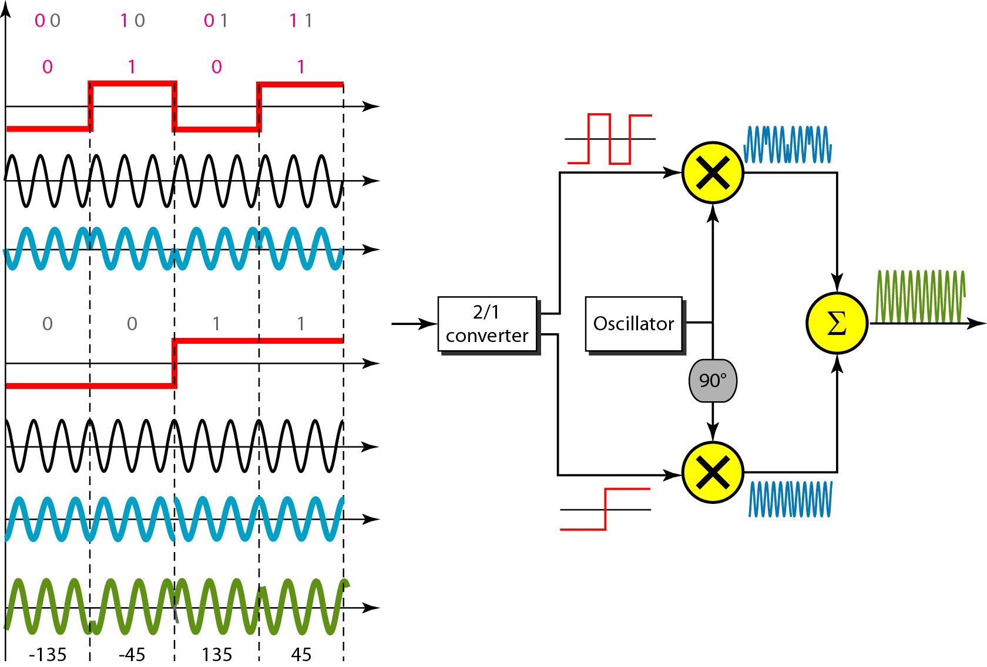
3.2 Quadrature PSK (QPSK)
Figure QPSK and its implementation

Slide 29
Example
Find the bandwidth for a signal transmitting at 12 Mbps for QPSK. The value of d = 0.
Solution
For QPSK, 2 bits is carried by one signal element. This means that r = 2. So the signal rate (baud rate) is S = N × (1/r) = 6 Mbaud. With a value of d = 0, we have B = S = 6 MHz.

Slide 30
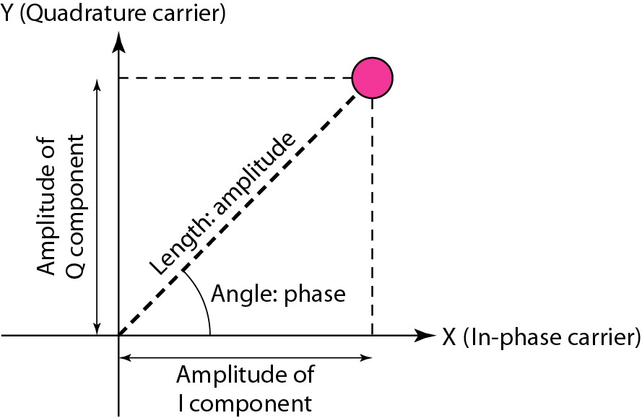
CONSTELLATION DIAGRAM
Figure Concept of a constellation diagram

Slide 31
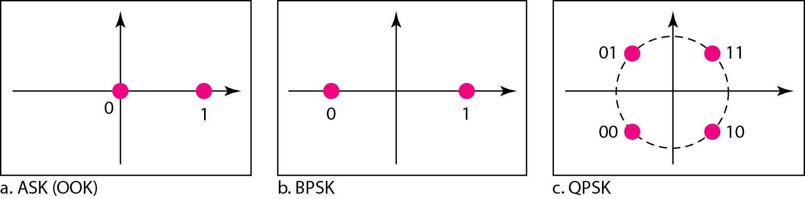
Example
Show the constellation diagrams for an ASK (OOK), BPSK, and QPSK signals.
Solution
Figure shows the three constellation diagrams.
Figure Three constellation diagrams

Slide 32
4. Quadrater Amplitude Modulation(QAM)
In Quadrater Amplitude Modulation we use two carrier with two phase (one inphase and other out of phase) and different amplitude level for each carrier.
The minimum bandwidth required for QAM transmission is the same as that required for ASK and PSK transmission.
Part a shows four different signal element types using a unipolar NRZ signal to modulate each carrier.
Part b shows 4-QAM using polar NRZ same as QPSK.
Part c shows signal with two positive levels to modulate each of the two carriers.
Part d shows 16-QAM constellation of a signal with eight levels four positive and four negative.

Slide 33
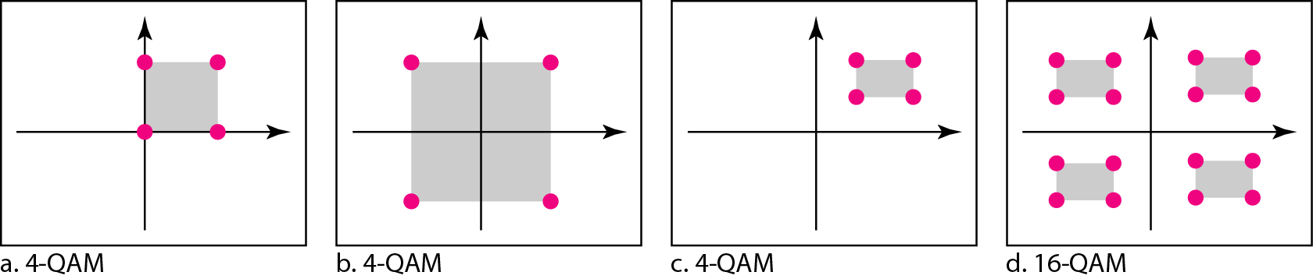
Quadrature Amplitude Modulation (QAM)
QAM is a combination of ASK and PSK.
Figure Constellation diagrams for some QAMs

Slide 34
2. Analog to Analog Conversion
Analog-to-analog conversion is the representation of analog information by an analog signal.
One may ask why we need to modulate an analog signal; it is already analog. Modulation is needed if the medium is bandpass in nature or if only a bandpass channel is available to us.
For example Radio signal has narrow bandwidth so signal produce by each station is low-pass signal all in the same range. So to listen all station signal need to shift in bandpass range.
Three way analog to analog conversion possible.
Amplitude Modulation(AM)
Frequency Modulation(FM)
Phase Modulation(PM)

Slide 35
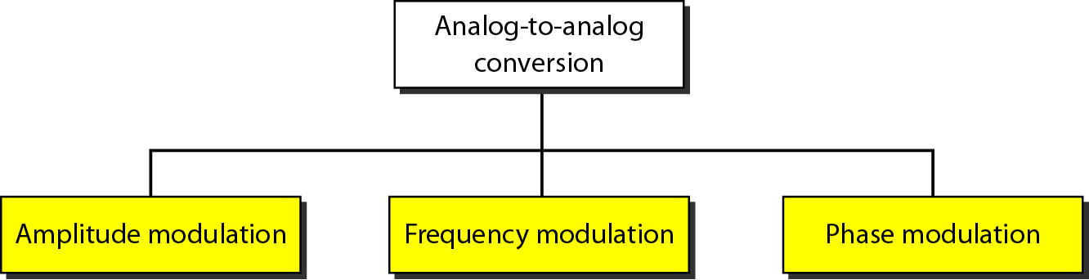
Figure Types of analog-to-analog modulation

Slide 36
1. Amplitude Modulation
In AM transmission the carrier signal is modulated so that its amplitude varies with the changing amplitude of the modulating signal.
The frequency and phase of the carrier remain the same only the amplitude changes to follow variations in the information.
The modulation creates a bandwidth that is twice the bandwidth of the modulating signal and covers a range centered on the carrier frequency.
Signal component above and below the carrier frequency carry exactly the same information.
FCC (federal comm commission) allows 10khz for each AM station(5khz actual)
There is a gap of 10 khz between two AM band two avoid interference.

Slide 37
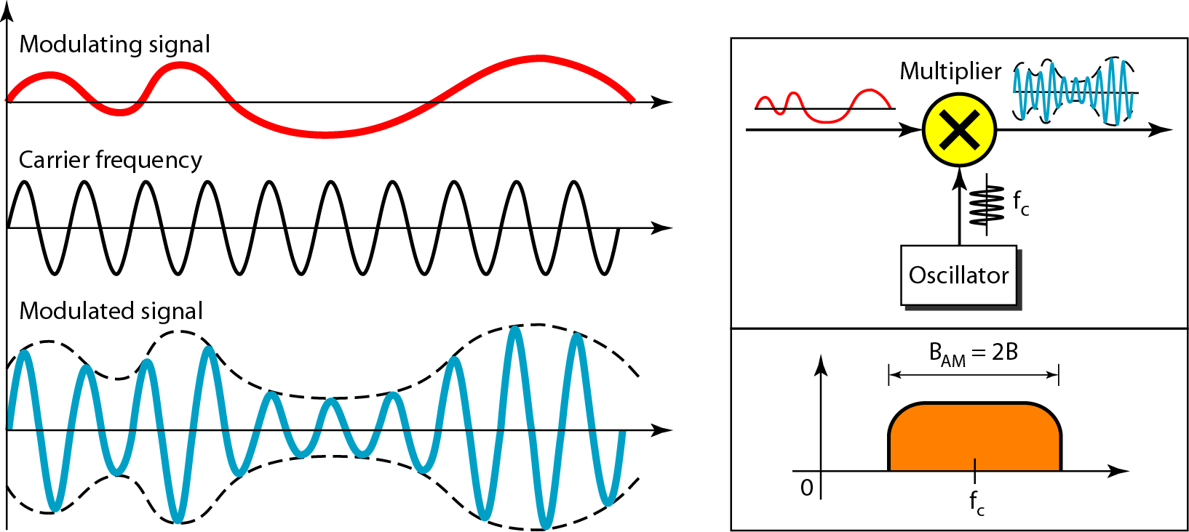
1. Amplitude Modulation (AM)
Figure Amplitude modulation

Slide 38
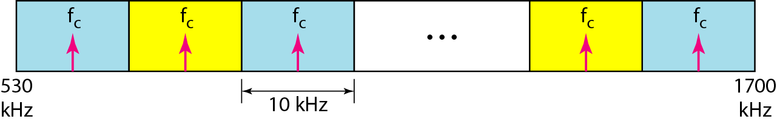
The total bandwidth required for AM can be determined
from the bandwidth of the audio signal: B_{AM} = 2B.
Figure AM band allocation

Slide 39
2. Frequency Modulation
In FM transmission, the frequency of the carrier signal is modulated to follow the changing voltage level of the modulationg signal.
The peak amplitude and phase of the carrier signal remain constant, but as the amplitude of the information signal changes the frequency of the carrier changes correspondingly.
FM is implemented using Voltage controlled oscillator as with FSK.
The frequency of the oscillator changes according to the input voltage which is the amplitude of the modulating signal.
FM station ranges 88 to 108 MHZ. Station must be separated by at least 200 khz to keep their bandwidths from overlapping.
There are 100 potential FM bandwidth in area of which 50 can operate at any one time.

Slide 40
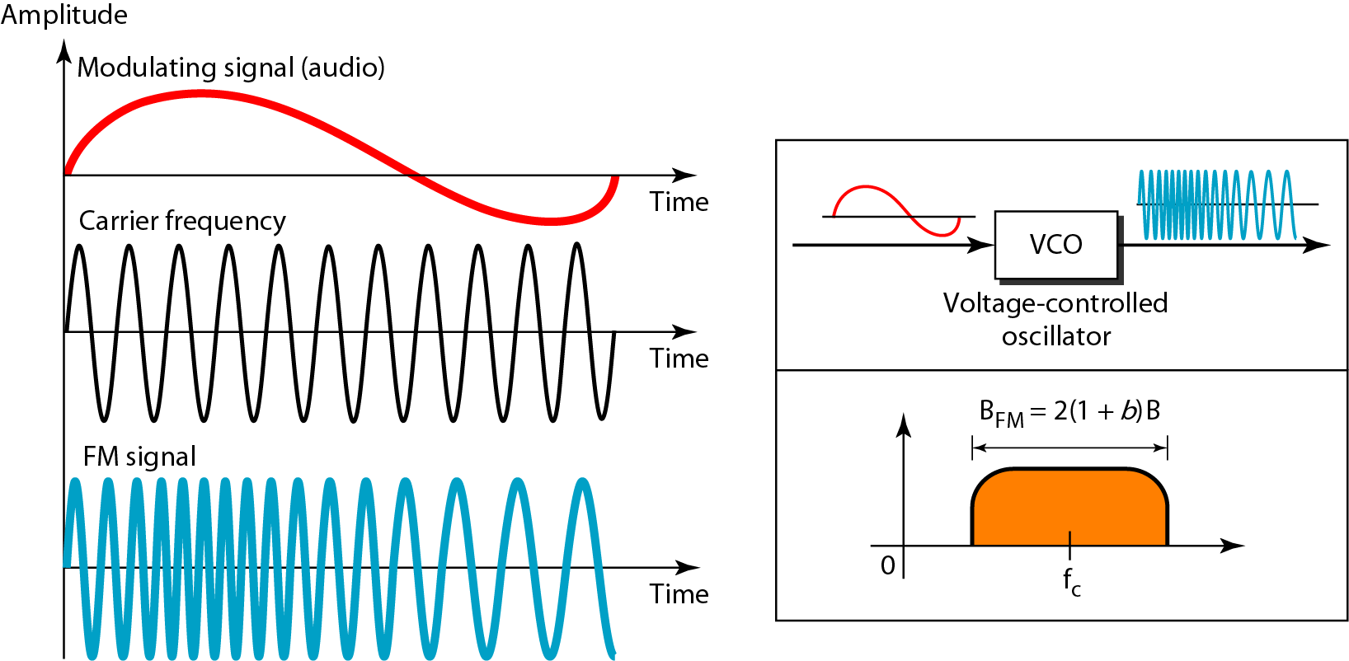
2. Frequency Modulation (FM)
Figure Frequency modulation

Slide 41
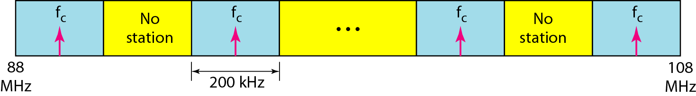
The total bandwidth required for FM can be determined from the bandwidth of the audio signal: B_{FM} = 2(1 + β)B.
Figure FM band allocation

Slide 42
3. Phase Modulation
In PM transmission, the phase of the carrier signal is modulated to follow the changing voltage level of the modulating signal.
The peak amplitude and Frequency of the carrier signal remain constant, but as the amplitude of the information signal changes the phase of the carrier changes correspondingly.
In PM instantaneous change in the carrier frequency is propositional to the derivative of the amplitude of the modulating signal.
It is implemented using voltage controlled oscillator along with a derivative.
The frequency of the oscillator changes according to the derivative of the input voltage which is the amplitude of the modulating signal.

Slide 43
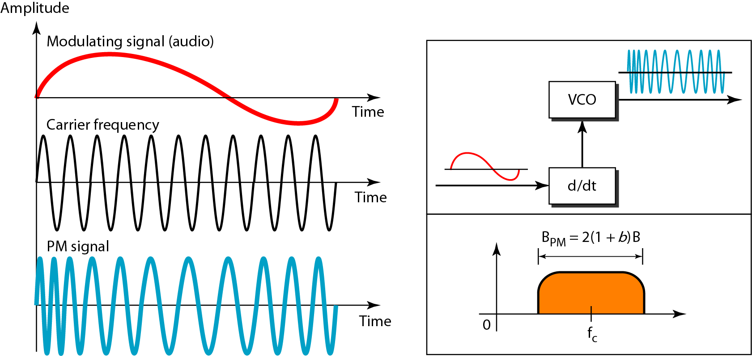
3. Phase Modulation (PM)
Figure Phase modulation

Slide 44
The total bandwidth required for PM can be determined from the bandwidth and maximum amplitude of the modulating signal: B_{PM} = 2(1 + β)B.

Slide 45
Thank You

